Slide 1
Realational Data Base Management System(RDBMS)
RDBMS stands for Relational Database Management System. RDBMS is a program used to maintain a relational database. RDBMS is the basis for all modern database systems such as MySQL, Microsoft SQL Server, Oracle, and Microsoft Access.

Slide 2
Abstract
Relational database was proposed with an objective to endow the user with a layer of abstraction. Data model of RDBMS is Tables/Relations, with primary key to uniquely identify a record and foreign key to interlink the tables thereby performing join on tables. RDBMS has several advantages such as abstraction, multiuser access, automatic optimization for searching, ACID properties enabling transaction support in extremely easy querying language, etc. However, as the data grow exponentially, scalability became a major issue for RDBMS leading to the introduction of nonrelational database.

Slide 3
Content
Introduction
Sub topics
Diagrams
Conclusion
Reference

Slide 4
Introduction
A relational database is a type of database that stores and provides access to data points that are related to one another. Relational databases are based on the relational model, an intuitive, straightforward way of representing data in tables. In a relational database, each row in the table is a record with a unique ID called the key. The columns of the table hold attributes of the data, and each record usually has a value for each attribute, making it easy to establish the relationships among data points.

Slide 5
Sub topics
Hierarchical Database
These DBMS employ parent and child relationships to store the data. Hierarchical DBMS is wide.
They store data in a tree-like structure so that it is easy to find and use. Similarly, the configuration of the DBMS is present in the nodes of the tree.
Network DBMS
Network DBMS supports many-to-many relations which results in complex database structures.
RDM Server is a major example of the network DBMS.
Relational DBMS
Relational DBMS stores data using the database relationships in the form of tables, also known as relations or tuples.
They do not support many to many relationships and have pre-defined data types that they can support. They are the most popular DBMS type in the industry.

Slide 6
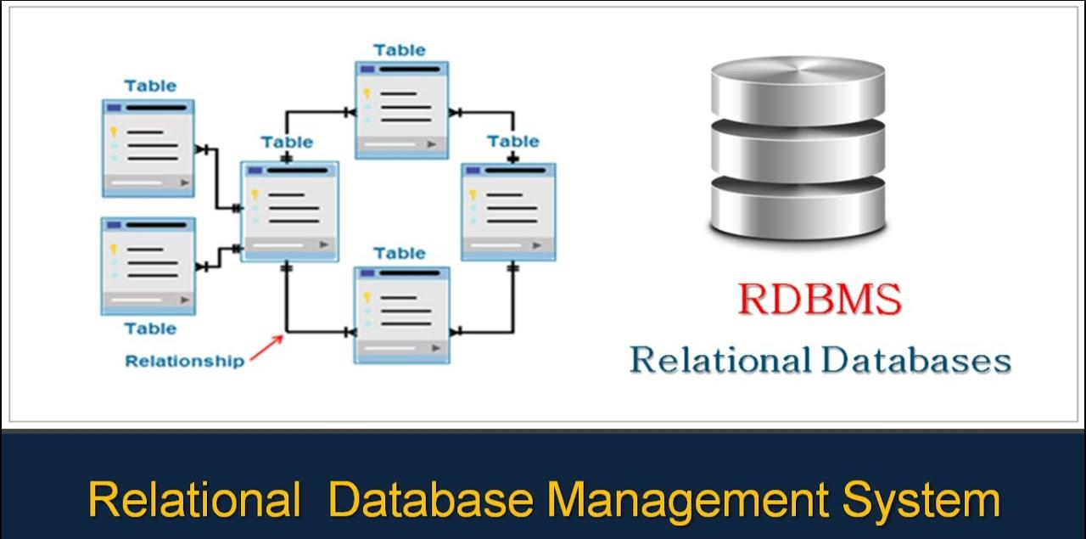
Diagrams

Slide 7
Conclusion
In summary, object-oriented database models are well-suited for use cases involving complex data structures, multimedia data, object-oriented applications, CAD/CAM, real-time systems, simulation and modeling, artificial intelligence, and version control. They provide a more natural and efficient way of modeling and managing complex data and relationships compared to traditional relational databases.

Slide 8
Reference
Codd, E. F. (1970). "A Relational Model of Data for Large Shared Data Banks". Communications of the ACM.
Ambler, Scott. "Relational Databases 101: Looking at the Whole Picture".
Date, Chris (5 May 2005). Database in depth: relational theory for practitioners. O'Reilly
Hershey, W.R.; Easthope, C.H. (1 December 1972). "A set theoretic data structure and retrieval language". ACM SIGIR Forum. Association for Computing Machinery. Retrieved 4 January 2024.

Slide 9


